Slide 1
A study on efficiency of kernel ridge censored regression using ensemble method
220228
Seong-Yun Hwang
Ph.D Candidate
Junior environmental researcher / National Institute of Environmental Research, Ministry of Environment, Republic of Korea

Slide 2
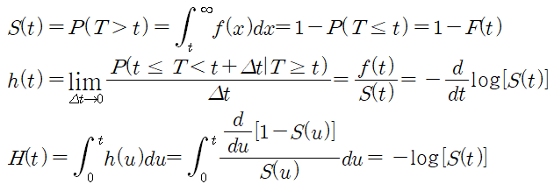

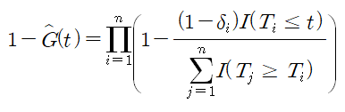
Motivation
Synthetic response
Kaplan-Meier estimator

Slide 3


Motivation
Kernel trick (for nonlinearity),
Ensemble method (for variance reduction)
Censored regression

Slide 4
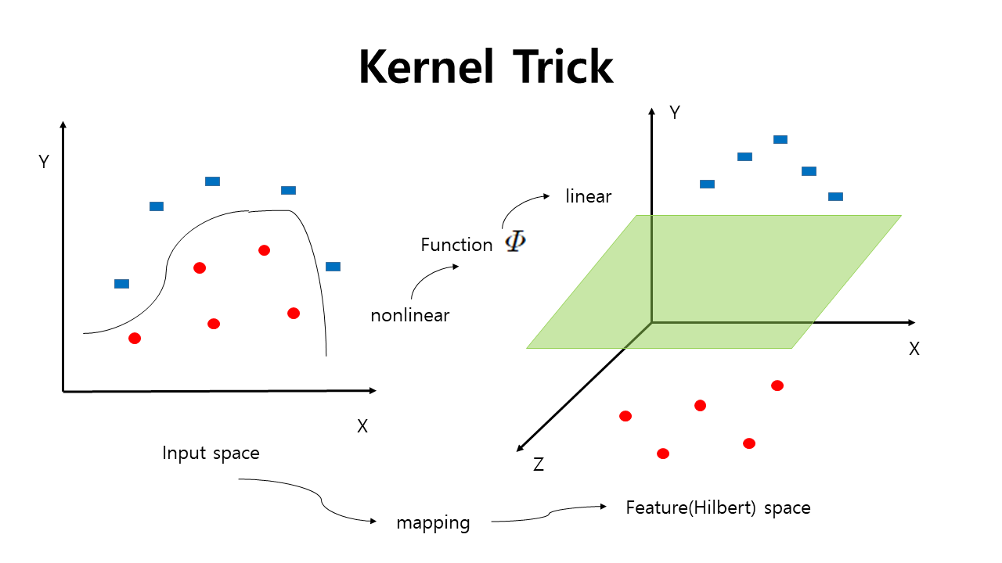
Kernel trick censored regression

Slide 5

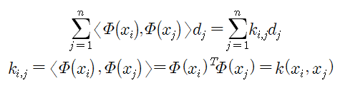




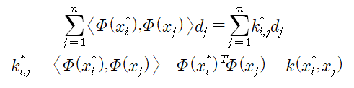
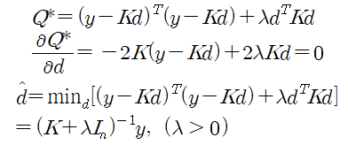

Kernel trick censored regression
Using Kernel function

Slide 6



Kernel trick censored regression
Criterion : synthetic response
Criterion : real response variable

Slide 7
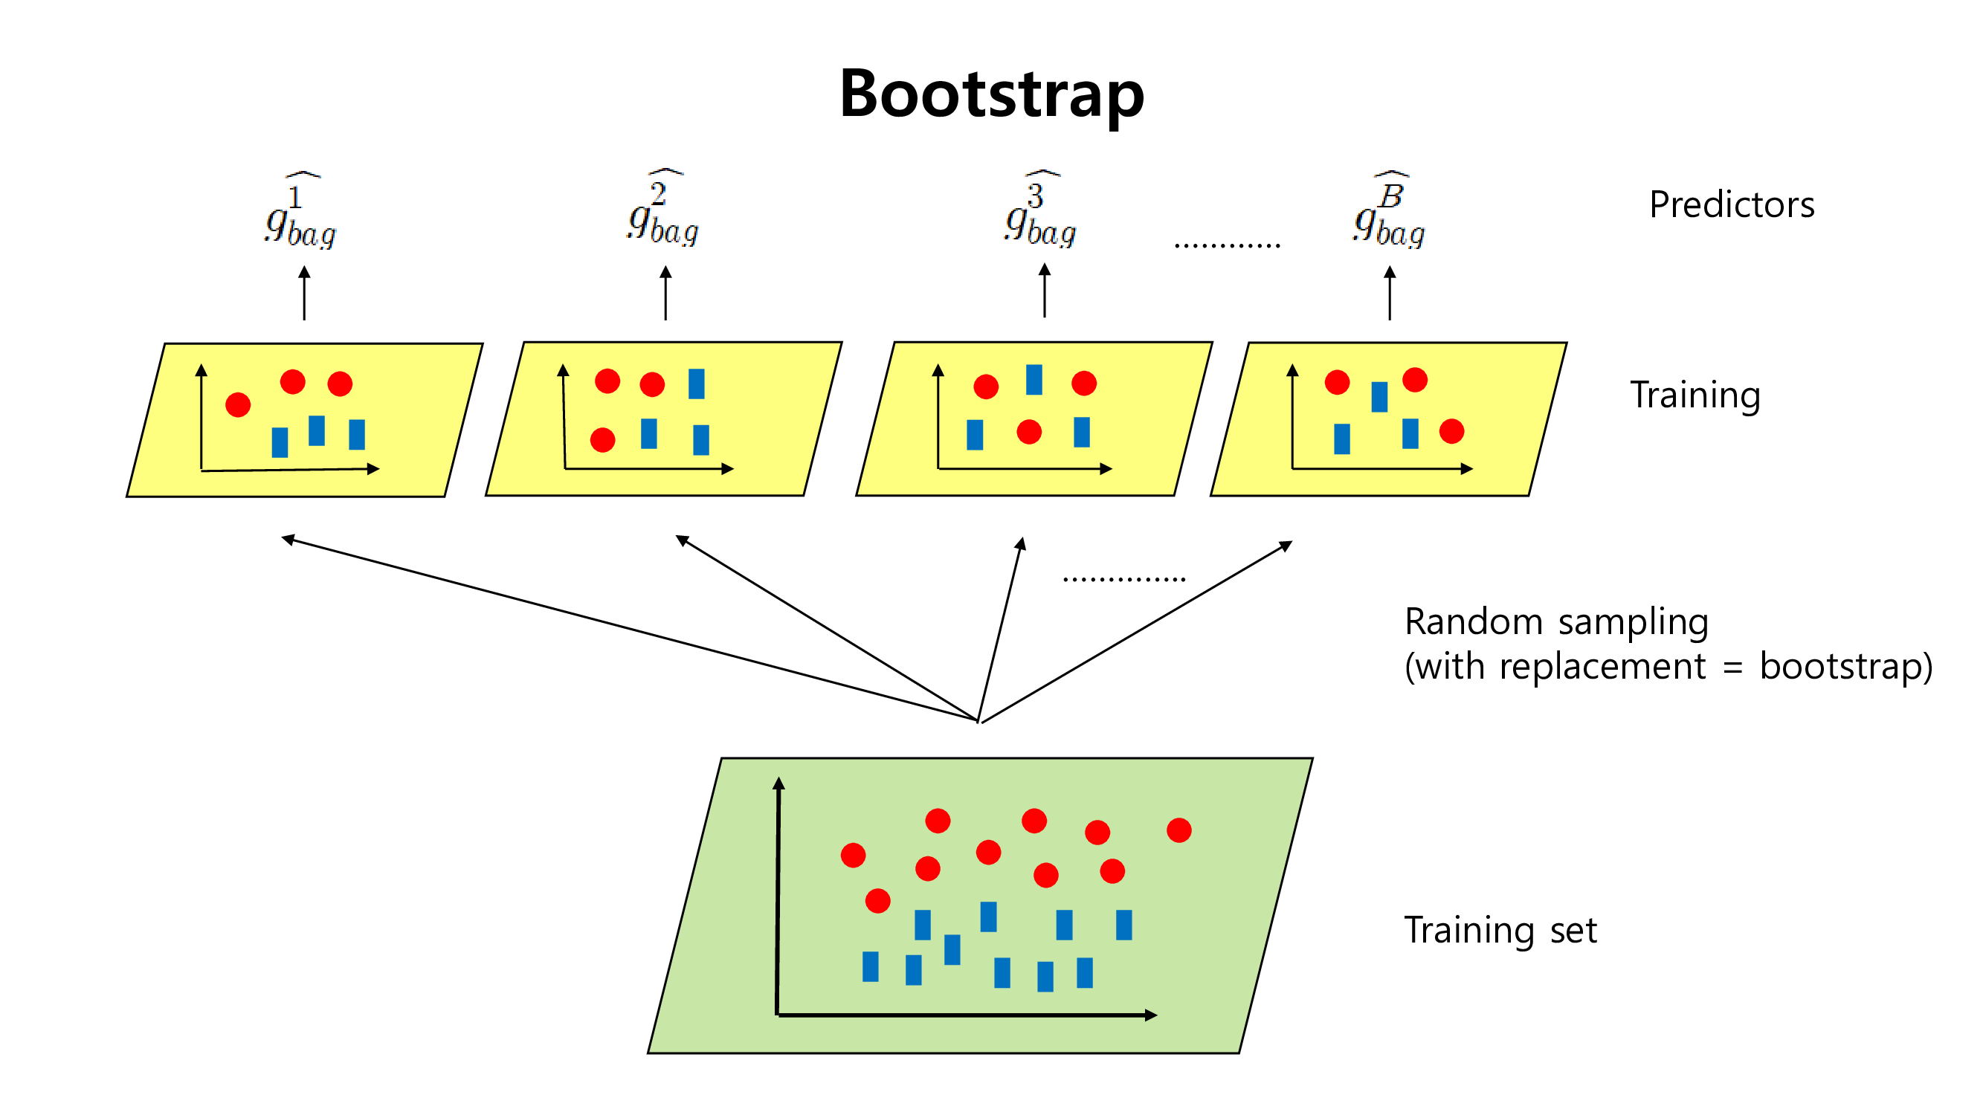
Ensemble method

Slide 8
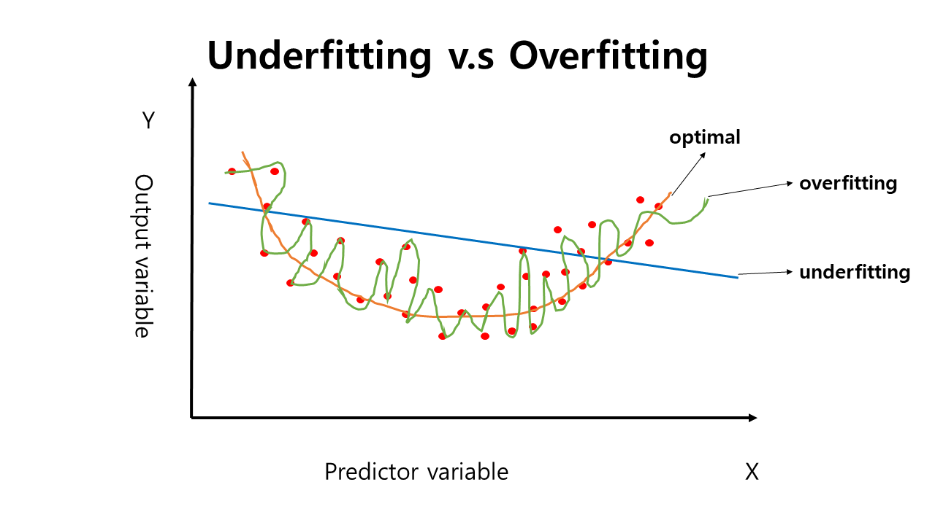
Ensemble method

Slide 9
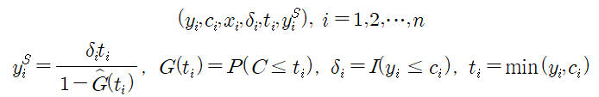

Kernel trick censored regression with Ensemble method
Kernel trick censored regression
Bth bootstrap sample
Bagging
Random Forest

Slide 10
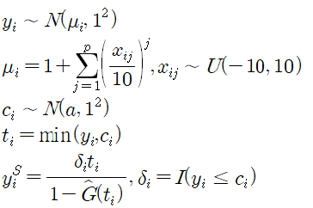
Simulation
PKR1 : Polynomial Kernel Ridge Regression with Synthetic Response
PKRS1 : Polynomial Kernel Ridge Regression with Sub-sampling and Synthetic Response
PKRB1 : Polynomial Kernel Ridge Regression with Bagging and Synthetic Response
PKRR1 : Polynomial Kernel Ridge Regression with Random Forest and Synthetic Response
GKR1 : Gaussian Kernel Ridge Regression with Synthetic Response
GKRS1 : Gaussian Kernel Ridge Regression with Sub-sampling and Synthetic Response
GKRB1 : Gaussian Kernel Ridge Regression with Bagging and Synthetic Response
GKRR1 : Gaussian Kernel Ridge Regression with Random Forest and Synthetic Response
PKR2 : Polynomial Kernel Ridge Regression with Generated(Original) Response
PKRS2 : Polynomial Kernel Ridge Regression with Sub-sampling and Generated(Original) Response
PKRB2 : Polynomial Kernel Ridge Regression with Bagging and Generated(Original) Response
PKRR2 : Polynomial Kernel Ridge Regression with Random Forest and Generated(Original) Response
GKR2 : Gaussian Kernel Ridge Regression with Generated(Original) Response
GKRS2 : Gaussian Kernel Ridge Regression with Sub-sampling and Generated(Original) Response
GKRB2 : Gaussian Kernel Ridge Regression with Bagging and Generated(Original) Response
GKRR2 : Gaussian Kernel Ridge Regression with Random Forest and Generated(Original) Response

Slide 11
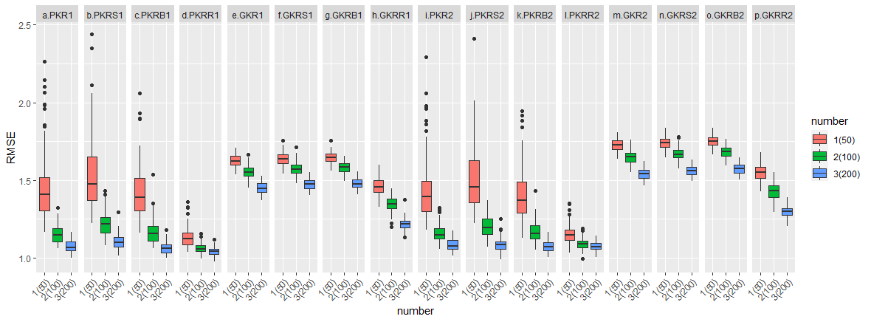
Simulation (p=3, censoring 0%)

Slide 12
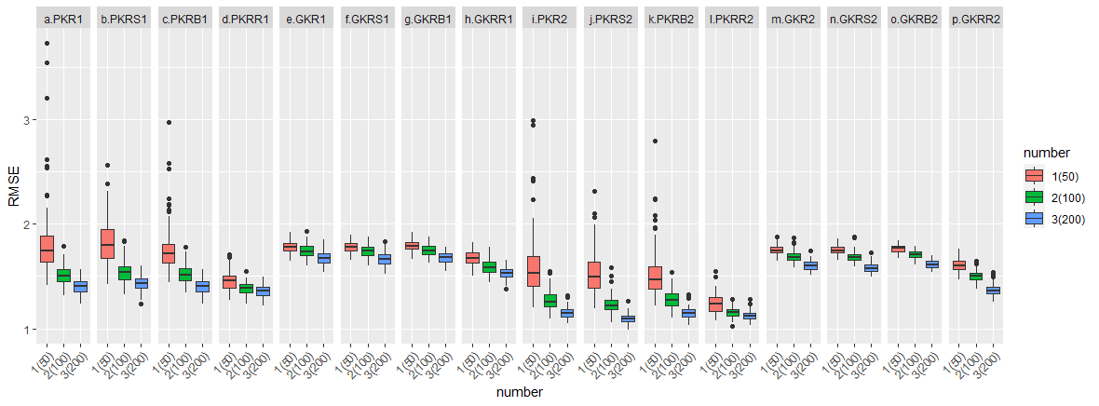
Simulation (p=3, censoring 10%)

Slide 13
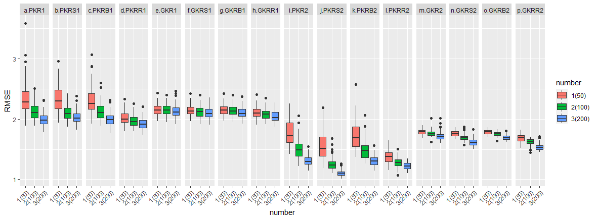
Simulation (p=3, censoring 30%)

Slide 14
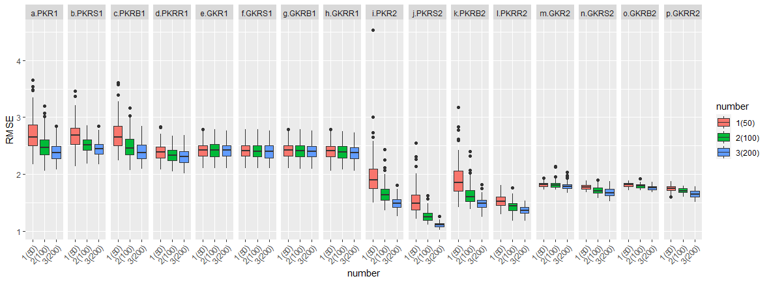
Simulation (p=3, censoring 50%)

Slide 15
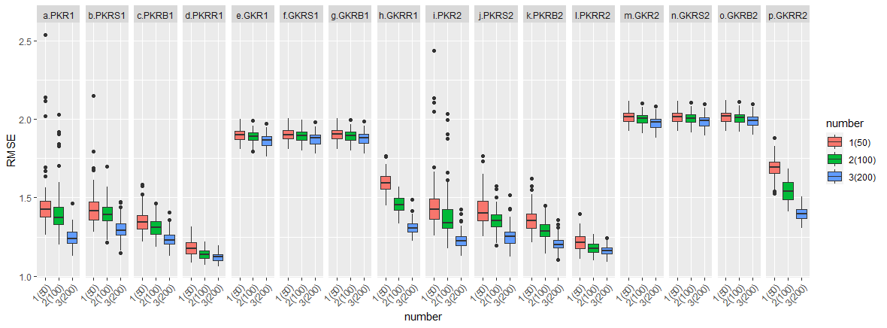
Simulation (p=5, censoring 0%)

Slide 16
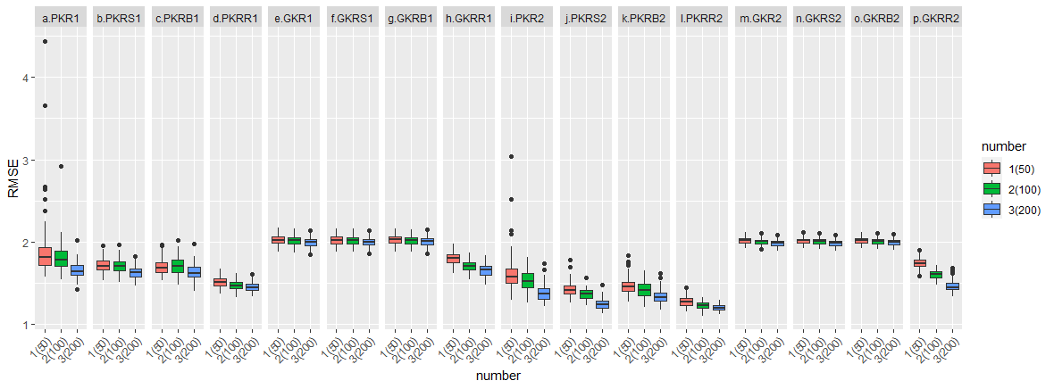
Simulation (p=5, censoring 10%)

Slide 17
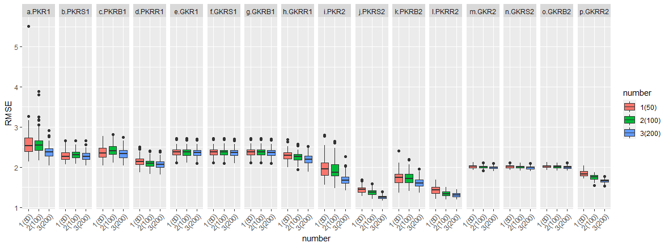
Simulation (p=5, censoring 30%)

Slide 18
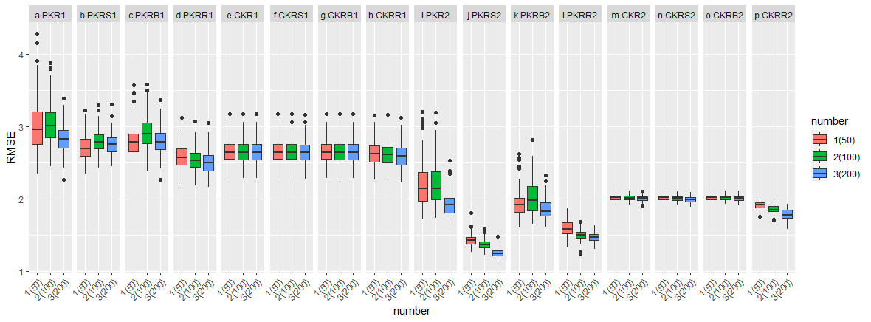
Simulation (p=5, censoring 50%)

Slide 19
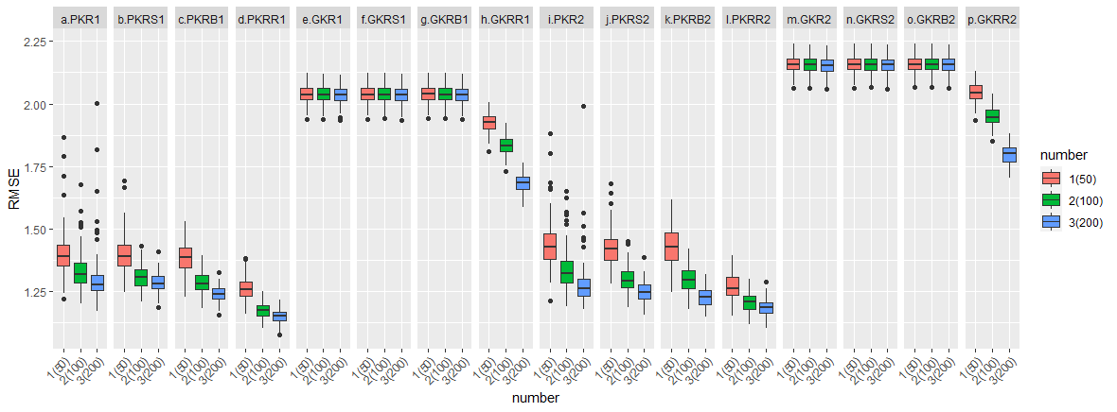
Simulation (p=7, censoring 0%)

Slide 20
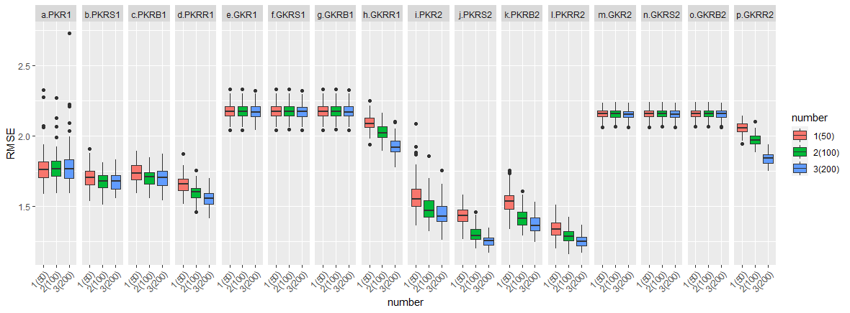
Simulation (p=7, censoring 10%)

Slide 21
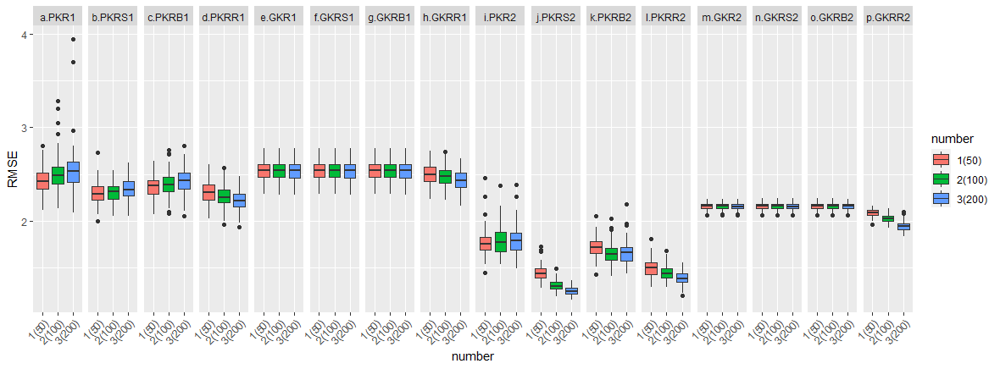
Simulation (p=7, censoring 30%)

Slide 22
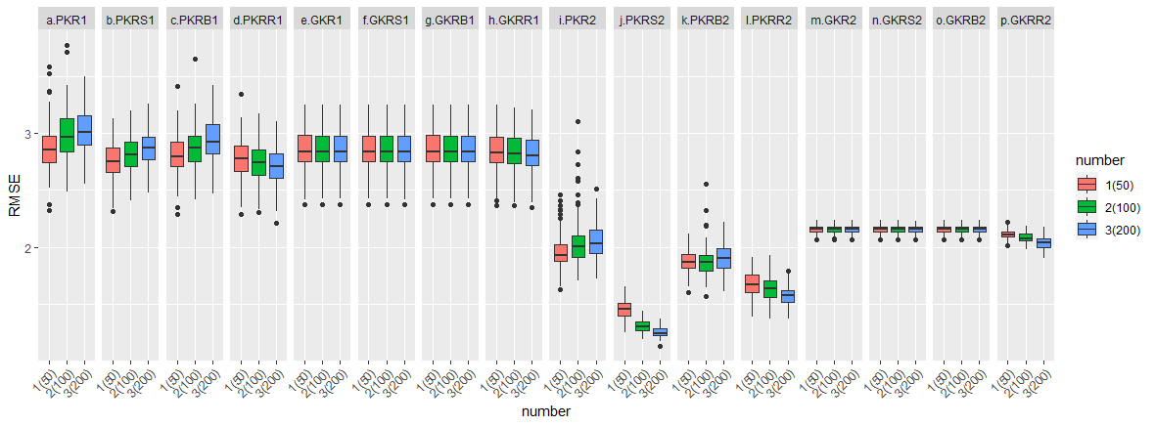
Simulation (p=7, censoring 50%)

Slide 23
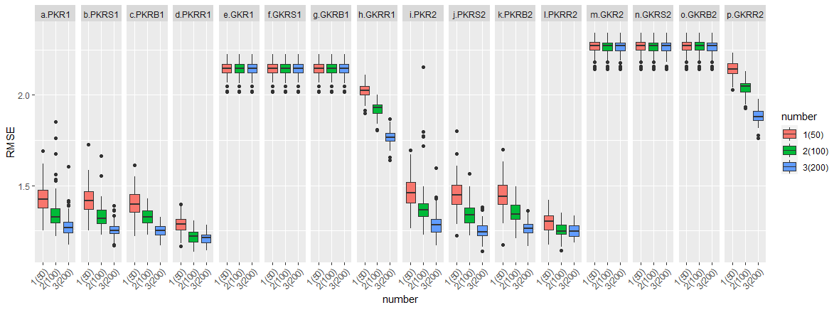
Simulation (p=9, censoring 0%)

Slide 24
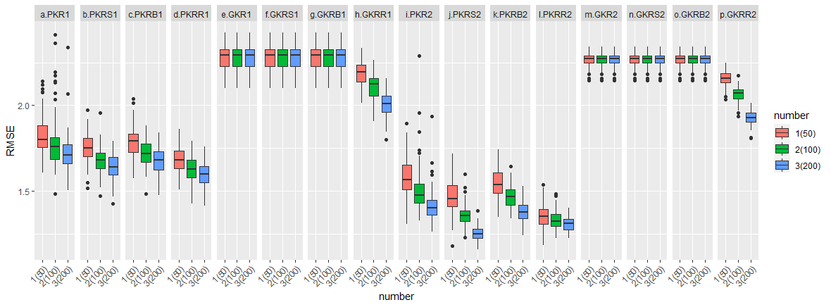
Simulation (p=9, censoring 10%)

Slide 25
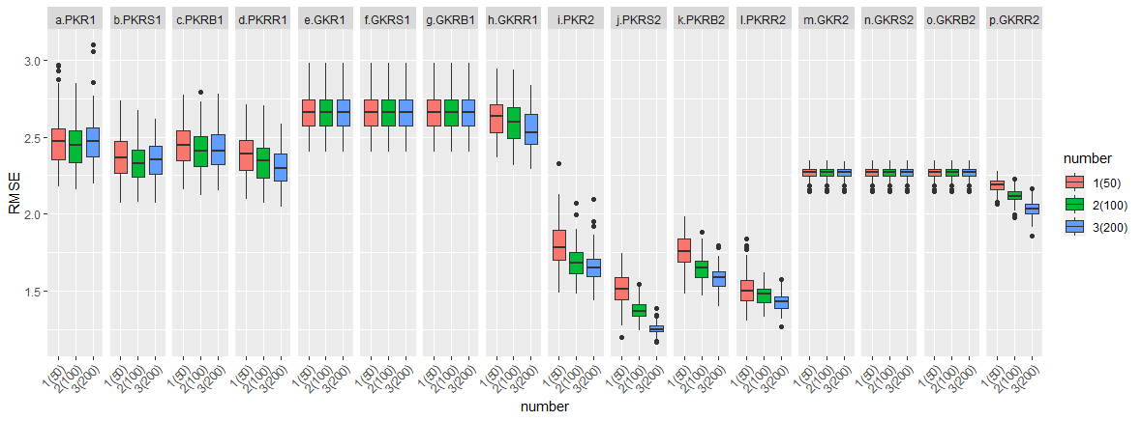
Simulation (p=9, censoring 30%)

Slide 26
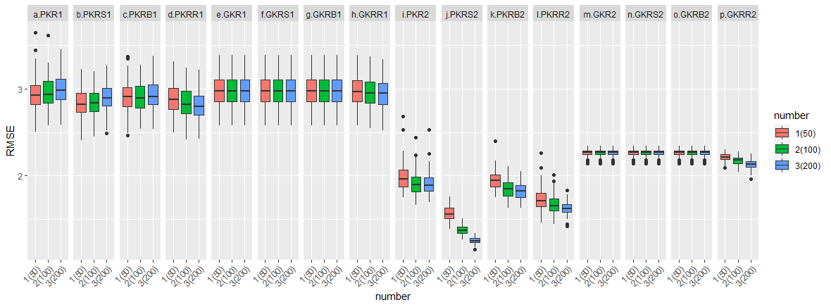
Simulation (p=9, censoring 50%)

Slide 27
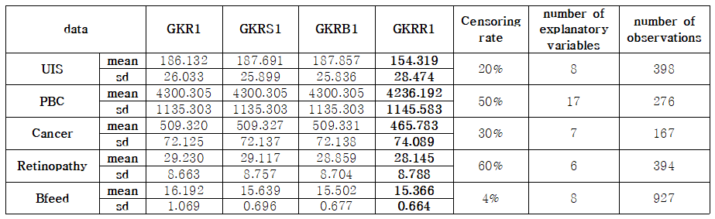
Real data

Slide 28
Q & A

